Slide 1
IE 411/511:
Visual Programming for Industrial Applications
Lecture Notes #2
Introduction to the
Visual Studio Express 2015 for Windows Desktop Integrated Development Environment

Slide 2
Introduction
In this module, the following topics will be covered
  The basics of the Visual Studio Express 2015 for Windows Desktop Integrated Development Environment (IDE) for writing, running and debugging your apps
  Visual Studio’s help features
  Key commands contained in the IDE’s menus and toolbars
  The purpose of the various kinds of windows in the Visual Studio Express 2015 for Windows Desktop IDE
  How to create, compile and execute a simple Visual Basic app that displays text and an image

Slide 3
Introduction (cont.)
Visual Studio Express 2015 for Windows Desktop
  Microsoft’s Integrated Development Environment (IDE) for creating, running and debugging applications (also called apps) written in various .NET programming languages
  From now on, the Visual Studio Express 2015 for Windows Desktop IDE will be referred to simply as VSE 2015
The examples, screen captures, and discussions in this module are based on the VSE 2015
Examples will work on full versions of Visual Studio as well

Slide 4
VSE 2015 IDE Overview
Once VSE 2015 begins execution, the Start Page is displayed
The Start Page contains a list of links to Visual Studio resources and web-based resources
You can return to the Start Page at any time by selecting VIEW > Start Page

Slide 5
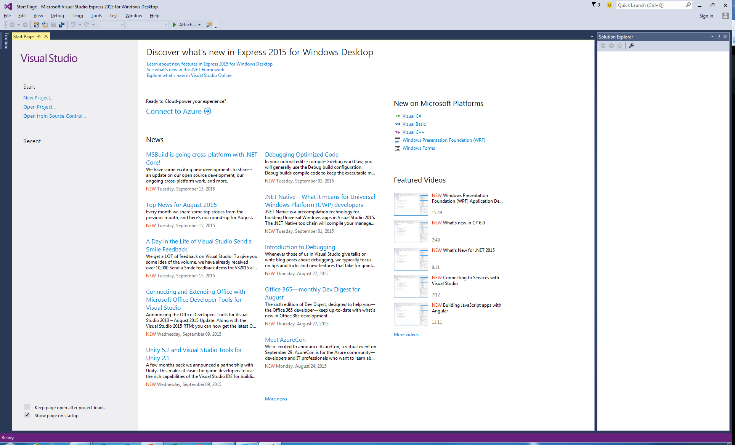
VSE 2015 IDE Overview (cont.)
New Project button
Start Page tab
Latest News tab
Recent
projects
will be
listed here
Solution
Explorer
(no projects
open)
Start Page links

Slide 6
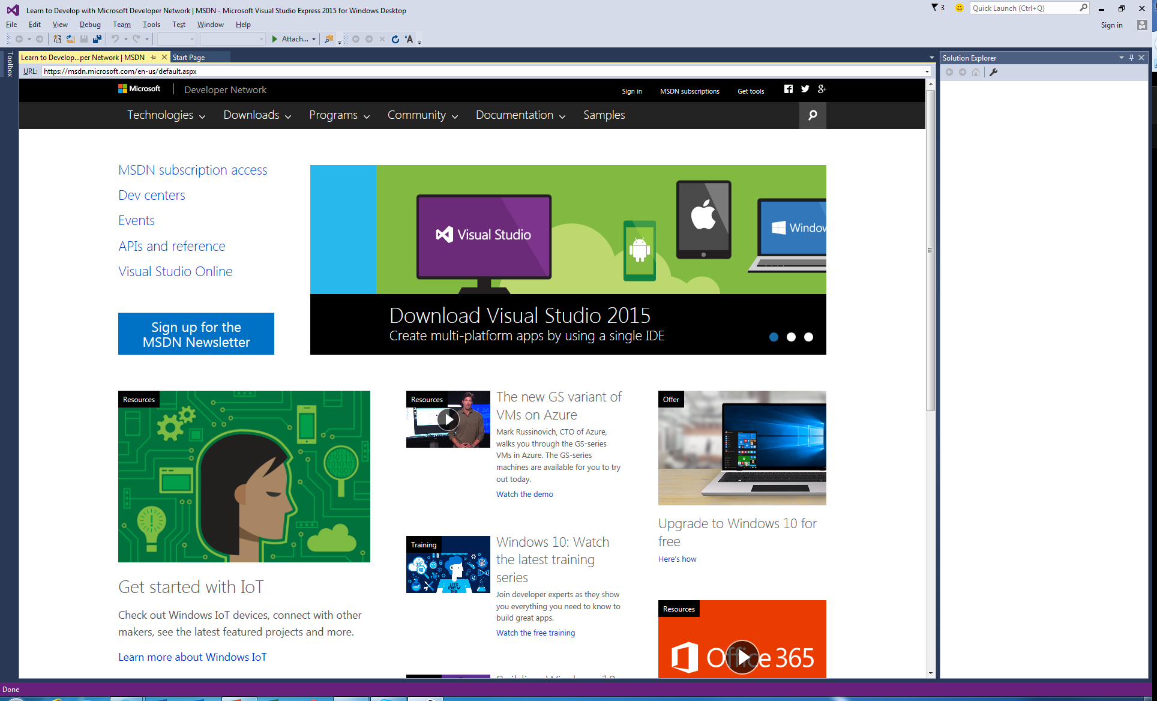
VSE 2015 IDE Overview (cont.)
The IDE also has an internal web browser
  Go to VIEW > Other Windows > Web Browser

Slide 7
VSE 2015 IDE Overview (cont.)
Creating a New Project
Select File > New Project... to create a new project
  On the Start Page, just click the link labeled New Project…
A project is a group of related files, such as the Visual Basic code and any images that might make up an app
Visual Studio organizes apps into projects and solutions, which contain one or more projects
  However, most apps consist of a solution containing a single project

Slide 8
VSE 2015 IDE Overview (cont.)
Creating a New Project (cont.)
When you select File > New Project… or click the New Project… link on the Start Page, the New Project dialog displays
Visual Studio provides several templates
  Project templates are the project types users can create in Visual Basic
In this course, we will concentrate on Windows Forms applications
  A Windows Forms application has a graphical user interface (GUI)

Slide 9
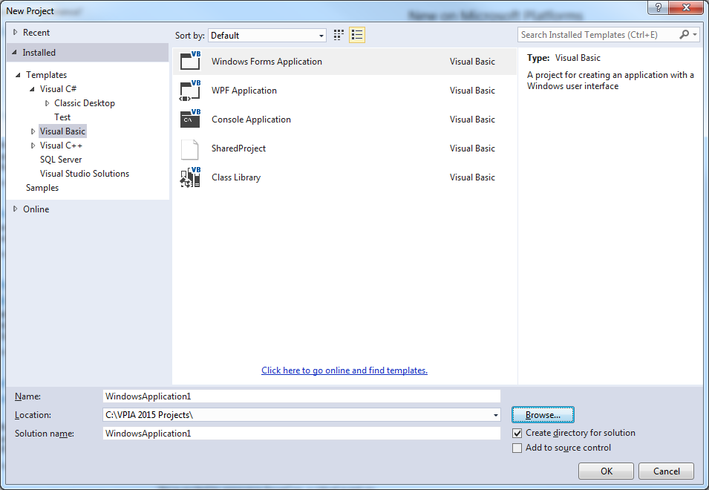
VSE 2015 IDE Overview (cont.)
Visual Basic Windows Forms Application (selected)
Default project name
(provided by Visual Studio)
Description of selected project
(provided by Visual Studio)

Slide 10
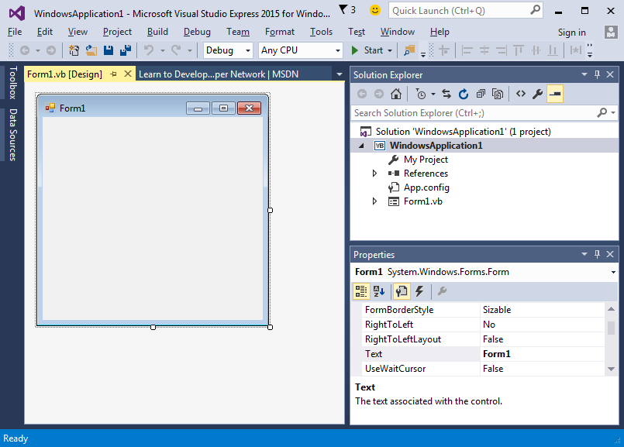
VSE 2015 IDE Overview (cont.)
Click OK to display the IDE in Design view
Menu in the menu bar
Solution Explorer window
Form (Windows Forms application)
Properties
window

Slide 11
VSE 2015 IDE Overview (cont.)
As you place controls on the Form, you will be able to modify their properties
The figure below shows where the Form’s title text can be modified
Text box (displaying the text Form1)
which can be modified

Slide 12
VSE 2015 IDE Overview (cont.)
Collectively, the Form and controls make up the app’s GUI
  Users enter data into the app by typing at the keyboard, by clicking the mouse buttons and in a variety of other ways
Programs use the GUI to display instructions and other information for users to view

Slide 13
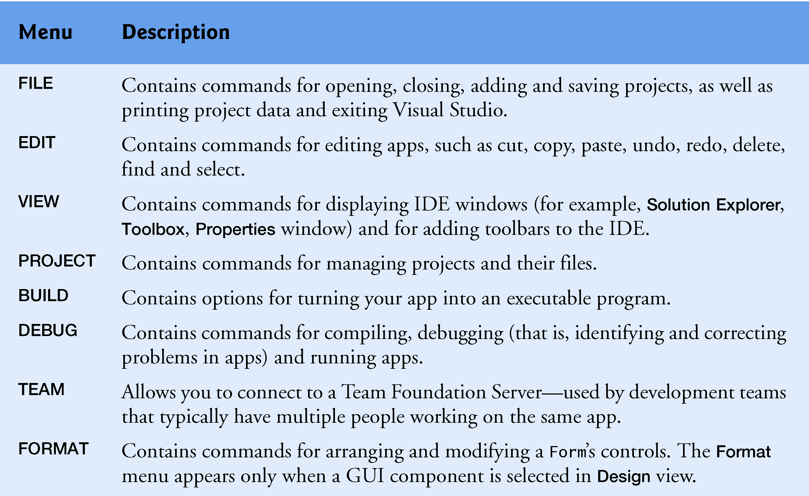
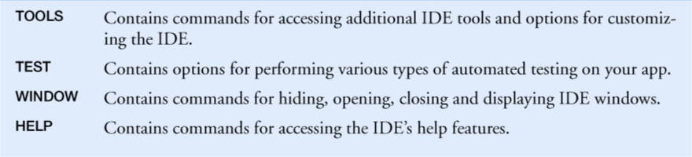
Menu Bar and Toolbar
Commands for managing the IDE and for developing, maintaining and executing apps are contained in menus
  The set of menus displayed depends on what you are currently doing in the IDE

Slide 14
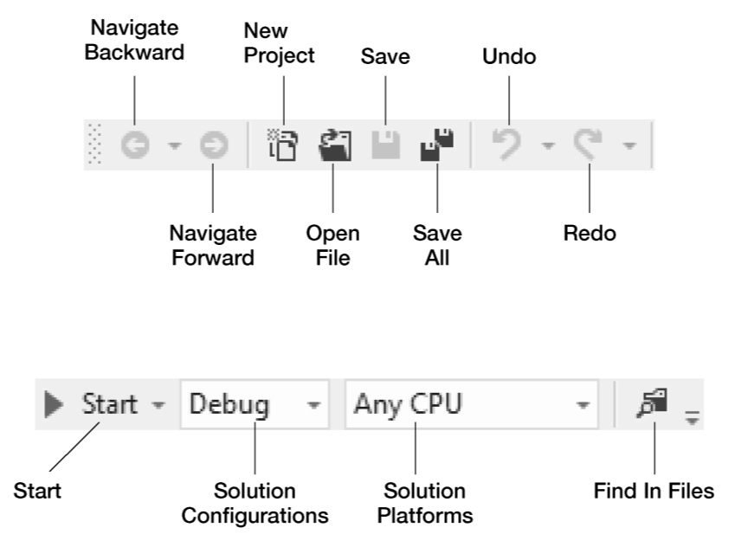
Menu Bar and Toolbar (cont.)
You can access common commands from the toolbar icons

Slide 15
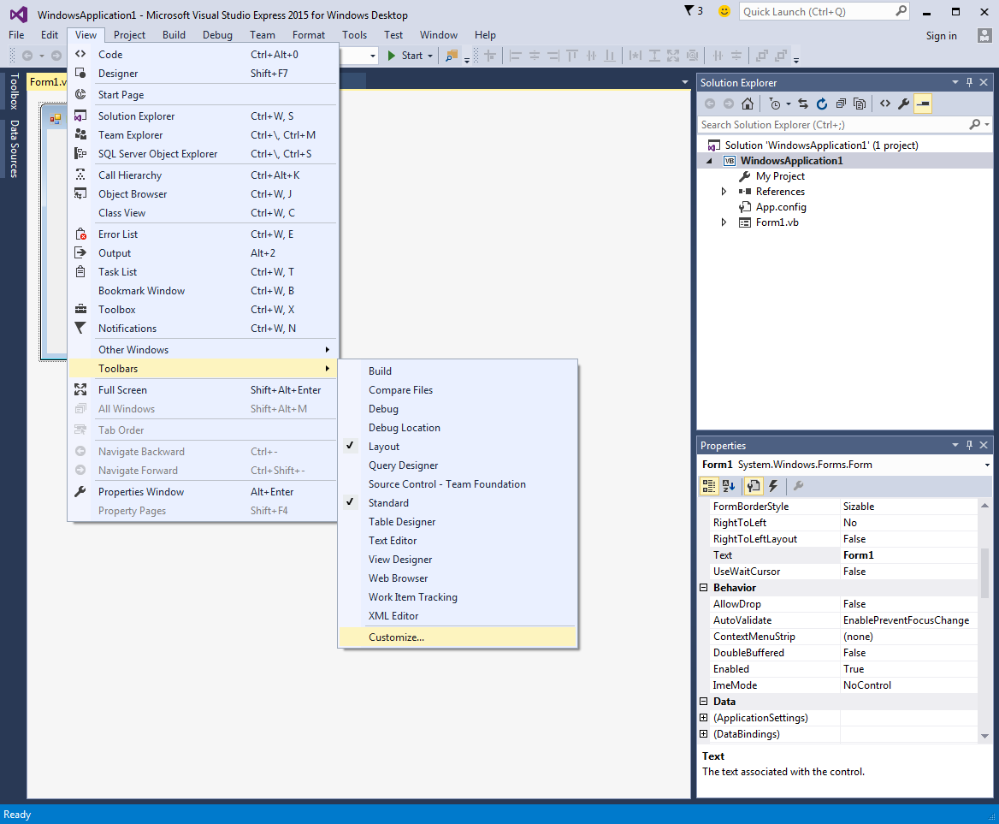
Menu Bar and Toolbar (cont.)
You can customize which toolbars are displayed by selecting View > Toolbars
  Each toolbar you select is displayed at the top of the Visual Studio window

Slide 16
Navigating the VSE 2015 IDE
The IDE provides windows for accessing project files and customizing controls
  Solution Explorer Window
  Toolbox Window
  Properties Window

Slide 17
Navigating the VSE 2015 IDE (cont.)
Visual Studio provides a space-saving feature called auto-hide
  When auto-hide is enabled, a tab appears along the edge of the IDE window
Icon for hidden window
(auto-hide enabled)

Slide 18
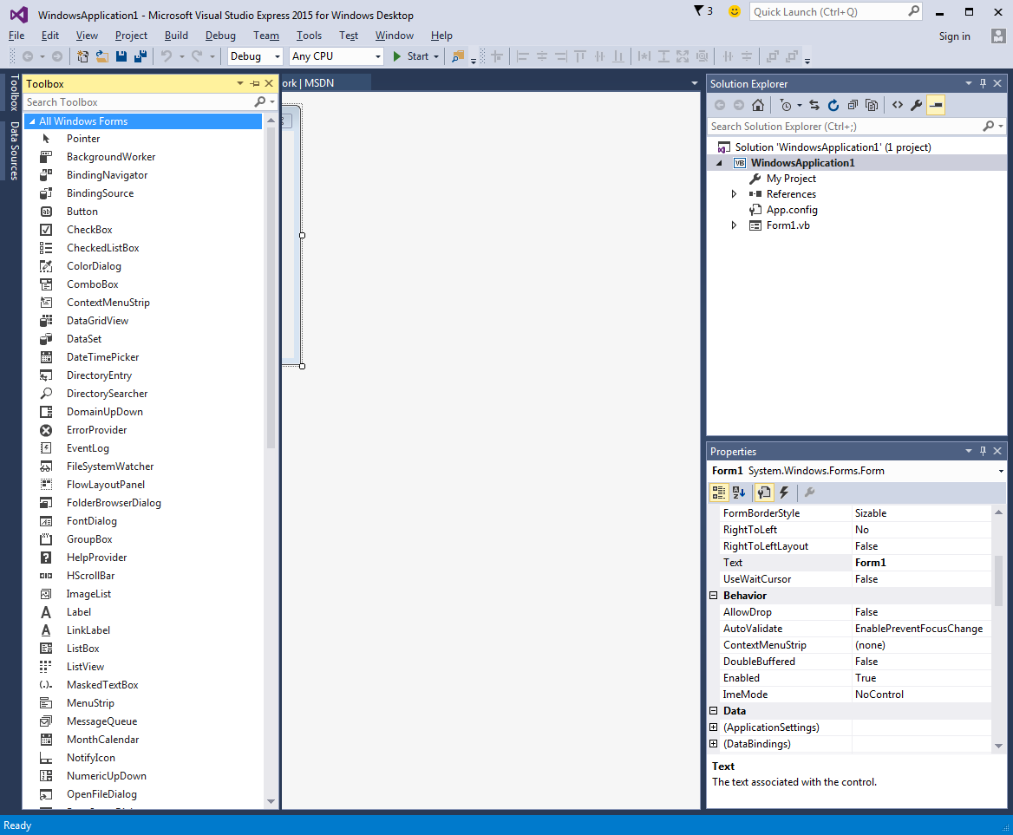
Navigating the VSE 2015 IDE (cont.)
Clicking one of these icons with the mouse pointer displays that window
Toolbox
title bar
Horizontal orientation for pin icon when auto-hide is enabled

Slide 19

Navigating the VSE 2015 IDE (cont.)
Solution Explorer Window
The Solution Explorer provides access to all of the solution’s files
The Solution Explorer window includes a toolbar that contains several icons

Slide 20
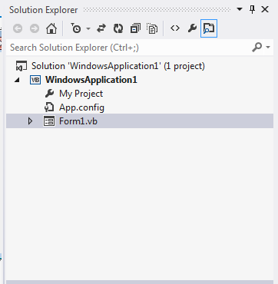
Navigating the VSE 2015 IDE (cont.)
Solution Explorer Window (cont.)
The solution’s startup project is the one that runs when you select Debug > Start Debugging
By default, the IDE displays only files that you may need to edit
  Other files that the IDE generates are hidden
  Clicking the Show All Files icon displays all the solution’s files, including those generated by the IDE
Startup project
Show All Files icon

Slide 21
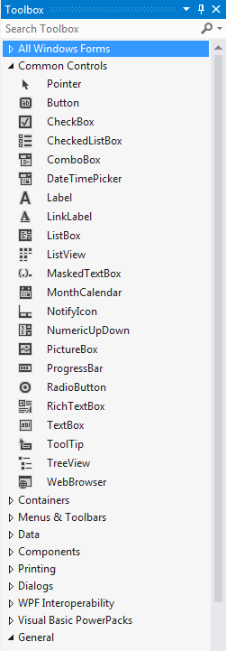
Navigating the VSE 2015 IDE (cont.)
Toolbox Window
The Toolbox contains the controls used to customize Forms
With visual app development, you can “drag and drop” controls onto the Form and the IDE will write the code that creates the controls for you
  Just as you do not need to know how to build an engine to drive a car, you do not need to know how to build controls to use them
Reusing preexisting controls saves time and money when you develop apps
Controls
Group
Names

Slide 22
Navigating the VSE 2015 IDE (cont.)
Properties Window
Select View > Properties Window
  The Properties window allows you to modify a control’s properties visually, without writing code
The Properties window displays the properties for the currently selected Form, control or file in Design view
At the top of the Properties window is the component selection drop-down list
The Properties window is crucial to visual app development
  Allows you to modify a control’s properties visually, without writing code

Slide 23
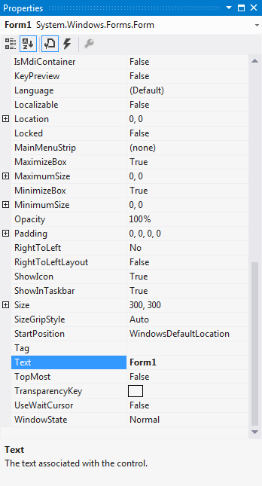
Navigating the VSE 2015 IDE (cont.)
Properties Window
Component selection drop-down list
Categorized icon
Alphabetical icon
Toolbar
Property
values
Properties
Selected property’s description

Slide 24
Using Help
Context-Sensitive Help
Visual Studio provides context-sensitive help pertaining to the “current content”
  i.e., The items around the location of the mouse cursor
To use context-sensitive help, click an item, then press the F1 key
  The help documentation is displayed in a web browser window
To return to the IDE, either close the browser window or select the IDE’s icon in your Windows task bar

Slide 25
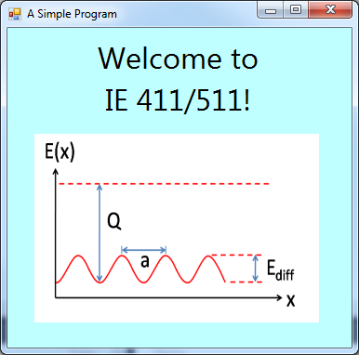
In Class Activity – Simple VB App
The figure below shows the result of a simple VB program as it executes
Label
control
PictureBox
control

Slide 26
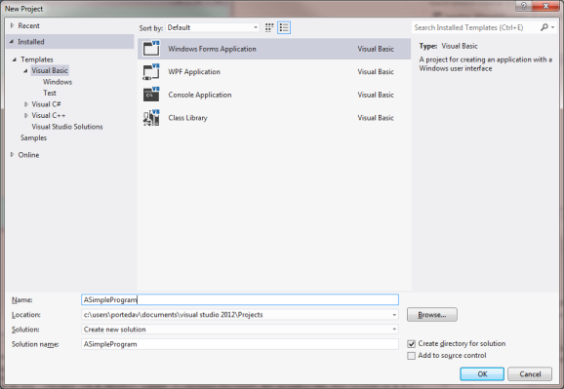
In Class Activity – Simple VB App (cont.)
Select File > New Project
  Or, click on New Project… on the Start page
From the template options, select Windows Forms Application
  Name the project ASimpleProgram
  To set the project location, click the Browse… button and then press OK
Type the
project name
Template types

Slide 27
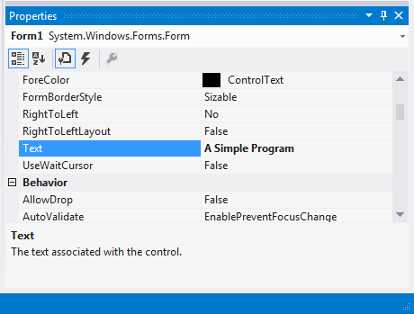
In Class Activity – Simple VB App (cont.)
When you first begin working in the IDE, it is in Design Mode
  The text in the Form’s title bar is determined by the Form’s Text property
  Change the value of the property Text as shown above and then press Enter
Name and type
of object
Selected property
Property
value
Property
description

Slide 28
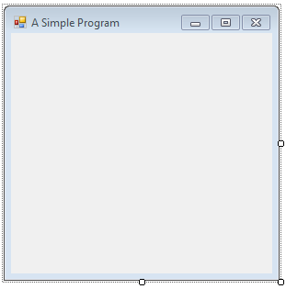
In Class Activity – Simple VB App (cont.)
Click and drag one of the Form’s enabled sizing handles to make the Form larger
Title bar
Enabled sizing
handles

Slide 29
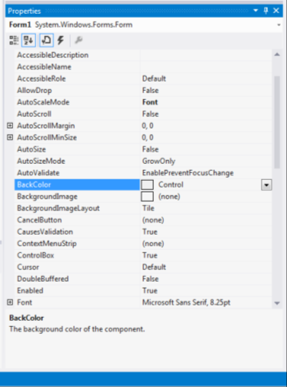
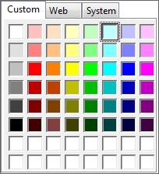
In Class Activity – Simple VB App (cont.)
Selecting BackColor in the Properties window causes a down-arrow button to appear on the right box
Clicking the arrow displays tabs for Custom, Web and System
  Click the Custom tab to display the palette
Current color
Down-arrow button
Custom
palette
Light blue

Slide 30
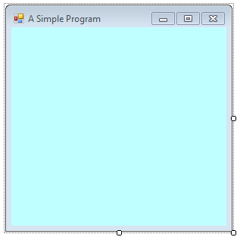
In Class Activity – Simple VB App (cont.)
Once you select a color, the palette closes and the Form’s background color changes
New background
color

Slide 31
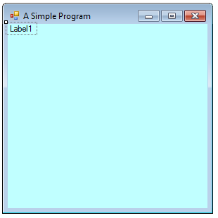
In Class Activity – Simple VB App (cont.)
Click on the tab labeled Toolbox to display the set of controls
Double click the Label control in the Toolbox
Label control

Slide 32
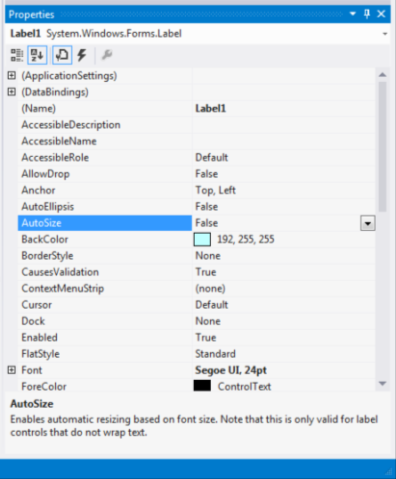
In Class Activity – Simple VB App (cont.)
Set the Label’s Text property to Welcome to Visual Basic!
Set the AutoSize property to False so that you can resize the Label on your own
AutoSize property

Slide 33
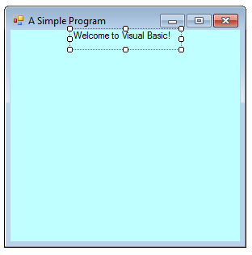
In Class Activity – Simple VB App (cont.)
Resize the Label so that the text fits
Center the Label control horizontally by selecting Format > Center In Form > Horizontally
Label centered with
updated Text
property
Sizing
handles

Slide 34
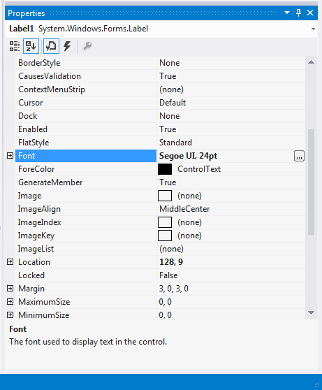
In Class Activity – Simple VB App (cont.)
Select the Font property, which causes an ellipsis button to appear next to the value
Ellipsis button

Slide 35
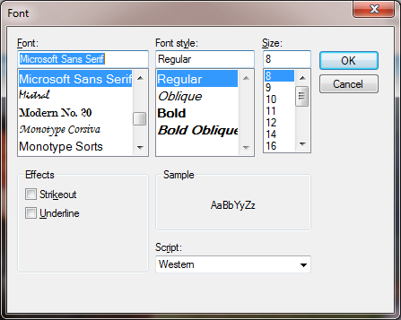
In Class Activity – Simple VB App (cont.)
When the ellipsis button is clicked, the Font dialog is displayed
  Under Font, select Segoe UI
  Under Size, select 24 points and click OK

Slide 36
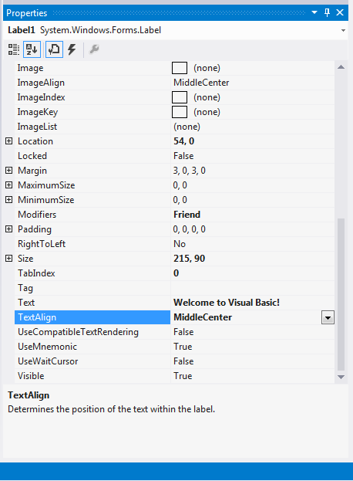

In Class Activity – Simple VB App (cont.)
Select the TextAlign property
Set the TextAlign property to MiddleCenter to have the text to appear centered in the Label
Text alignment
options
Middle-center
alignment option

Slide 37
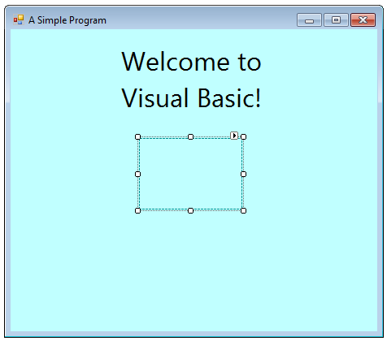
In Class Activity – Simple VB App (cont.)
The PictureBox control displays images
Locate the PictureBox in the Toolbox and double click it to add it to the Form
  Updated Label
  PictureBox

Slide 38
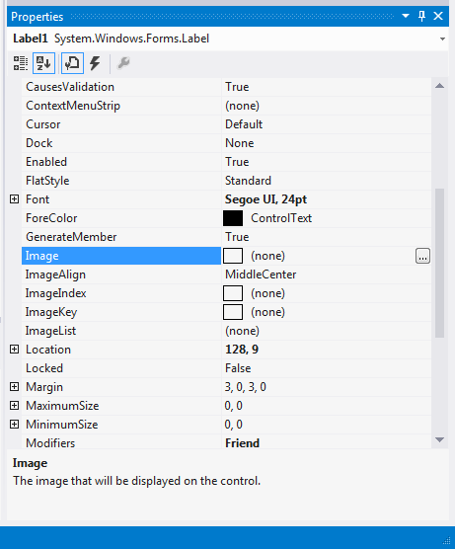
In Class Activity – Simple VB App (cont.)
Locate the Image property
No picture has been assigned, so the value of the Image property displays (none)
Image property value
(no image selected)

Slide 39
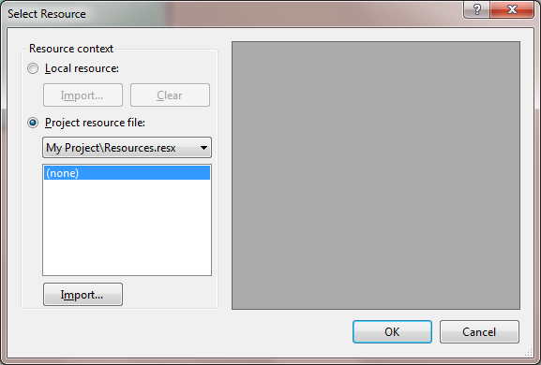
In Class Activity – Simple VB App (cont.)
Click the ellipsis button to display the Select Resource dialog

Slide 40
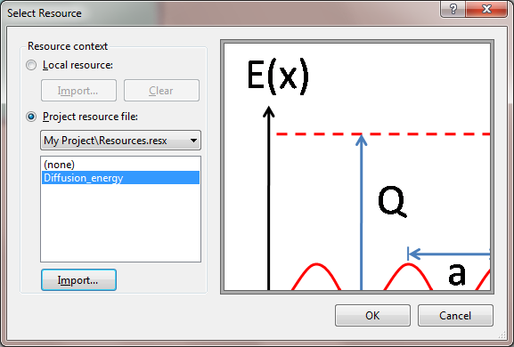
In Class Activity – Simple VB App (cont.)
Locate the option Project resource file
  Click the Import… button
Locate the file “Diffusion_energy.png”, select it and click Open
  The resource named Diffusion_energy represents “Diffusion_energy.png”
Click OK to place the image in your app
  Supported image formats include PNG, GIF, JPEG and BMP
Image file
name

Slide 41
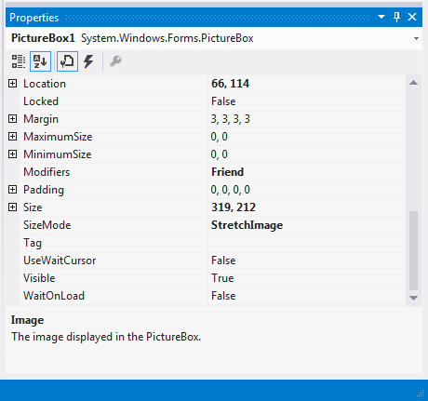
In Class Activity – Simple VB App (cont.)
To size the image to the PictureBox, change the SizeMode property to StretchImage
  Resize the PictureBox, making it larger
This is a good time to save your work
  Select File > Save All to save the entire solution
  x
  Ctrl + Shift + S
SizeMode
property
SizeMode
property set to
StretchImage

Slide 42
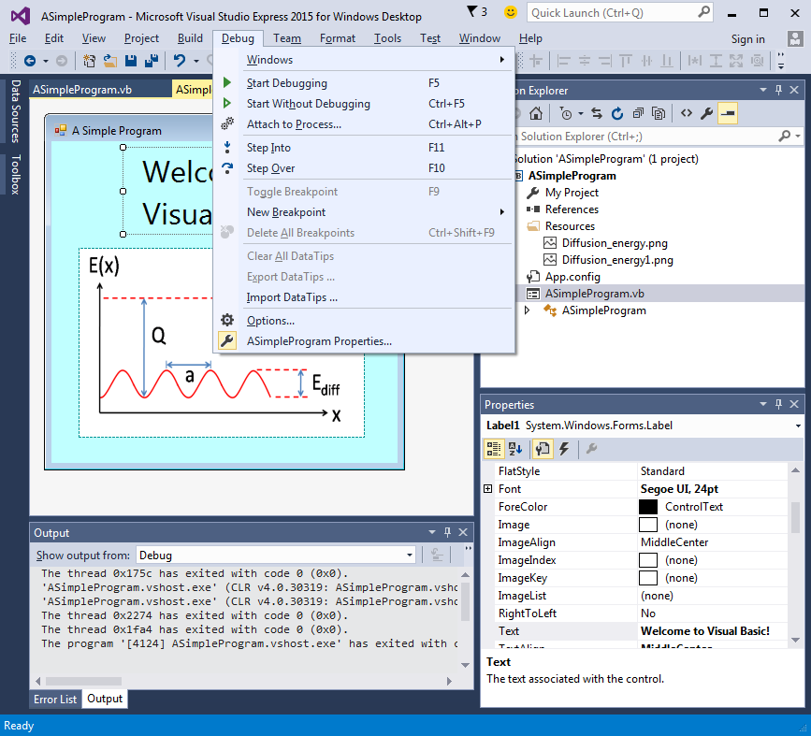
In Class Activity – Simple VB App (cont.)
Select Debug > Start Debugging to execute the program
Debug menu

Slide 43
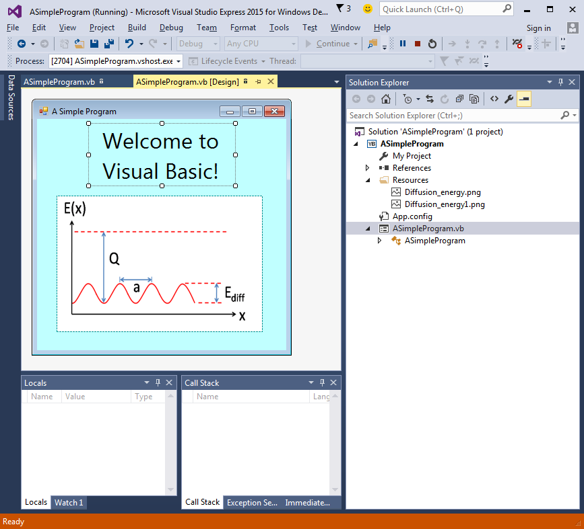
In Class Activity – Simple VB App (cont.)
In run mode, the program is executing, and you can interact with only a few of the IDE features
IDE displays text (Running) which
signifies that the program is executing
Running
program

